Slide 1
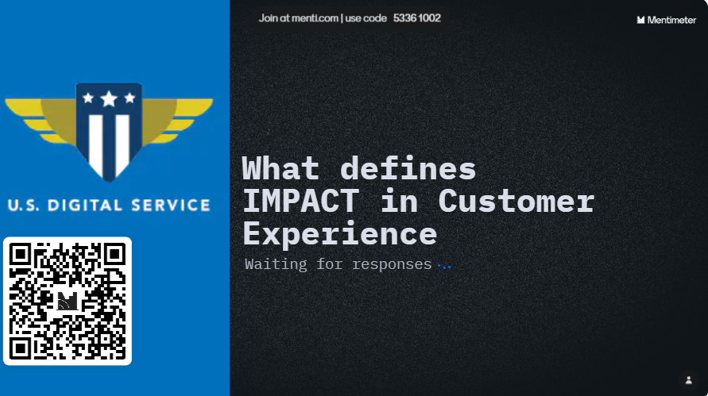
EQUITY IS EVERYONE’S JOB
Notes:
Icebreaker: to provoke a common understanding of how we're coming to 'impact', given impact is a goal of equity work

Slide 2
Moving the Needle Toward Better, Healthier Communities
Product Jam with the Equity Delivery Team
U.S. Digital Service // JANUARY 2024
Notes:
Start at 5 min mark
What to expect today?
A conversation that begins with Impact and closes with an opening to discuss Equity broadly and concretely
We’ll close with how to connect with us for consultations and equity toolkit

Slide 3


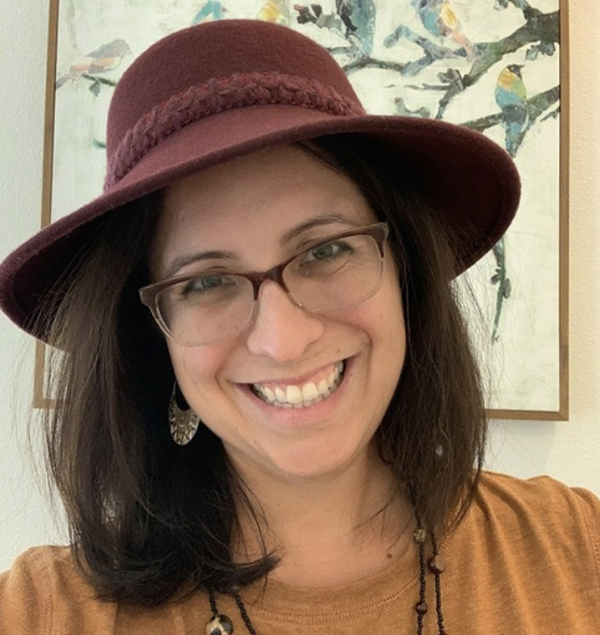

Meet the equity team
Celeste Espinoza
Jeremy Zitomer
Alex Bornkessel
Natasha Jamal
DEIA Director

Slide 4
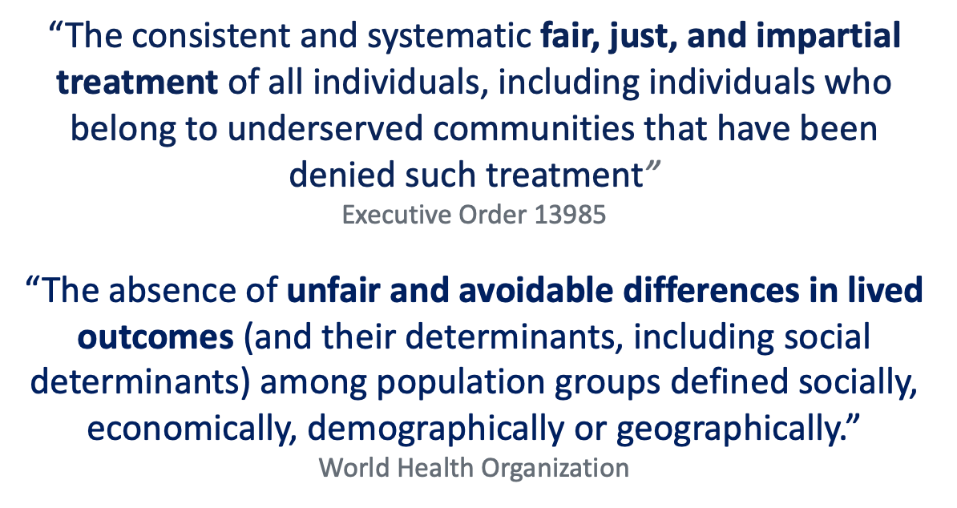
What is equity?
Notes:
Baseline: We look to create equity in process, outputs, and outcomes. None of those can be realized without the other.

Slide 5
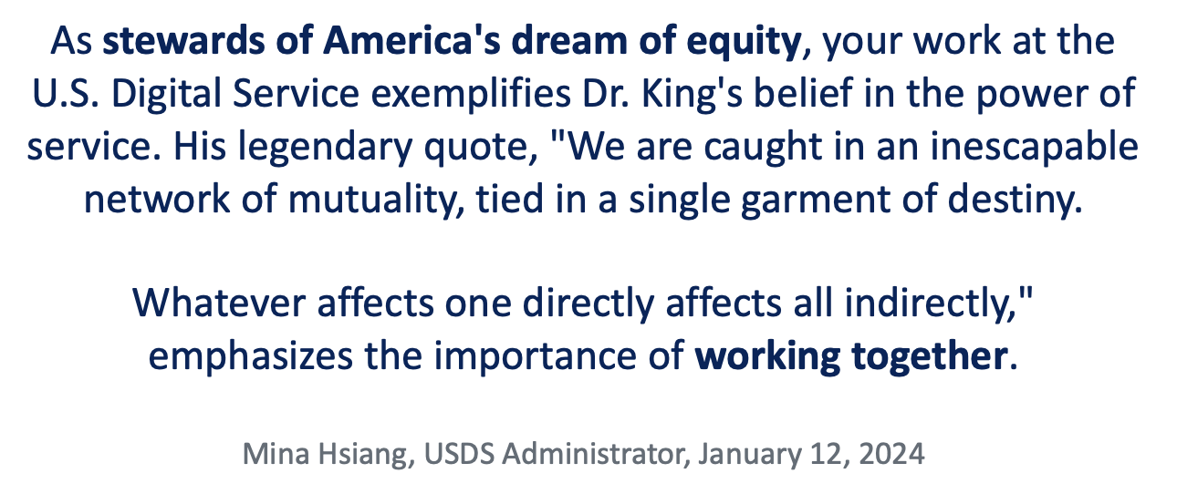
EQUITY IS EVERYONE's JOB
Notes:
No matter your role, equity should matter to you. No matter where you are with your equity fluency, journey – we can always learn more.
When it comes to equity, there is always room for improvement.
There’s always more to learn. So today, we’re going to learn from you – and courageous leaders in Product who are challenging norms and bringing best practices to the table.

Slide 6
Let's Chat
Notes:
Start w/ metrimeter – some discussion of results: are there commonalities? Differences? What's the learning moment, takeaway?

Slide 7
Share a moment where you’ve had to be a courageous leader to advance customer experience (CX) in a federal project or service.
Food for thought
How did you define CX and impact to your agency partners? How do you communicate CX and impact within USDS teams?
Notes:
20 min.

Slide 8
Share barriers you experience in delivering impact and equity as part of CX at the federal level.
Food for thought
How do we define equity at USDS? Who decides who is prioritized (or not at all prioritized) on these projects? Is there a strategy that has helped your team better communicate and deliver equity?
Notes:
20 min

Slide 9
We can get there together
Equity Toolkit includes three flagship tools to drive equity & impact, and other resources to spark innovative plays.
https://github.com/usds/equity_practice

Slide 10
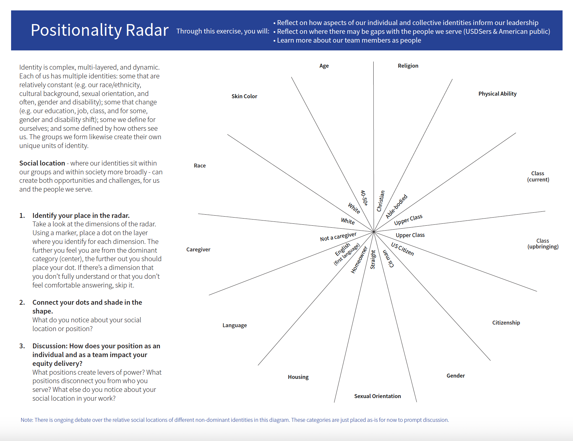
positionality
Develop better awareness on how a team’s lived experiences impact delivery, and highlight gaps and opportunities between the team’s experience and the communities being served.
Who’s using it: USDS Leadership, HRSA OPTN, FFS IVaaS, CX 0-5
Opportunities to use it: project or discovery kickoffs, team resets, new team member onboarding, when taking on new scope

Slide 11
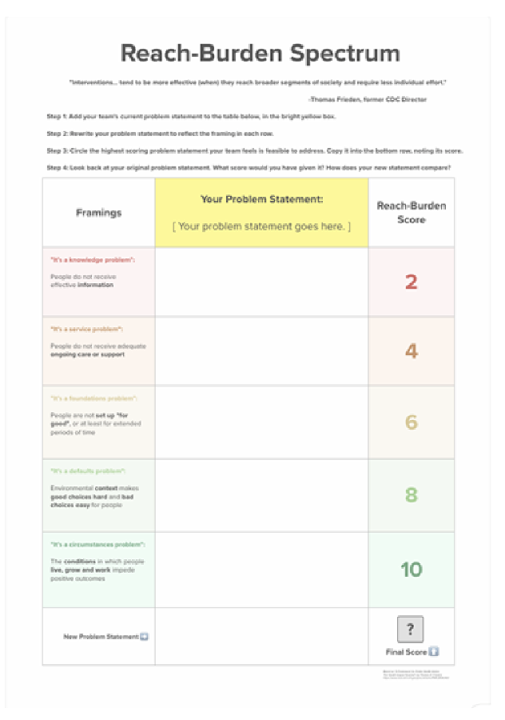
Reach-burden spectrum
Challenge teams to consider different levers as part of problem prioritization to plot maximum reach and minimize burden to people served.
Who’s using it: FFS IVaaS, HHS Grants.gov, CMS Cybersecurity, Project Toolkit, CX Disaster Relief
Opportunities to use it: post discovery, scoping exercises, early project planning
Notes:
Please do not add a stroke (outside border line) to photos or graphics.
To remove a stroke:
Right click on image
Choose “Format shape”
Under the paint bucket icon, expand the “Line”. Menu and choose “No line.”

Slide 12
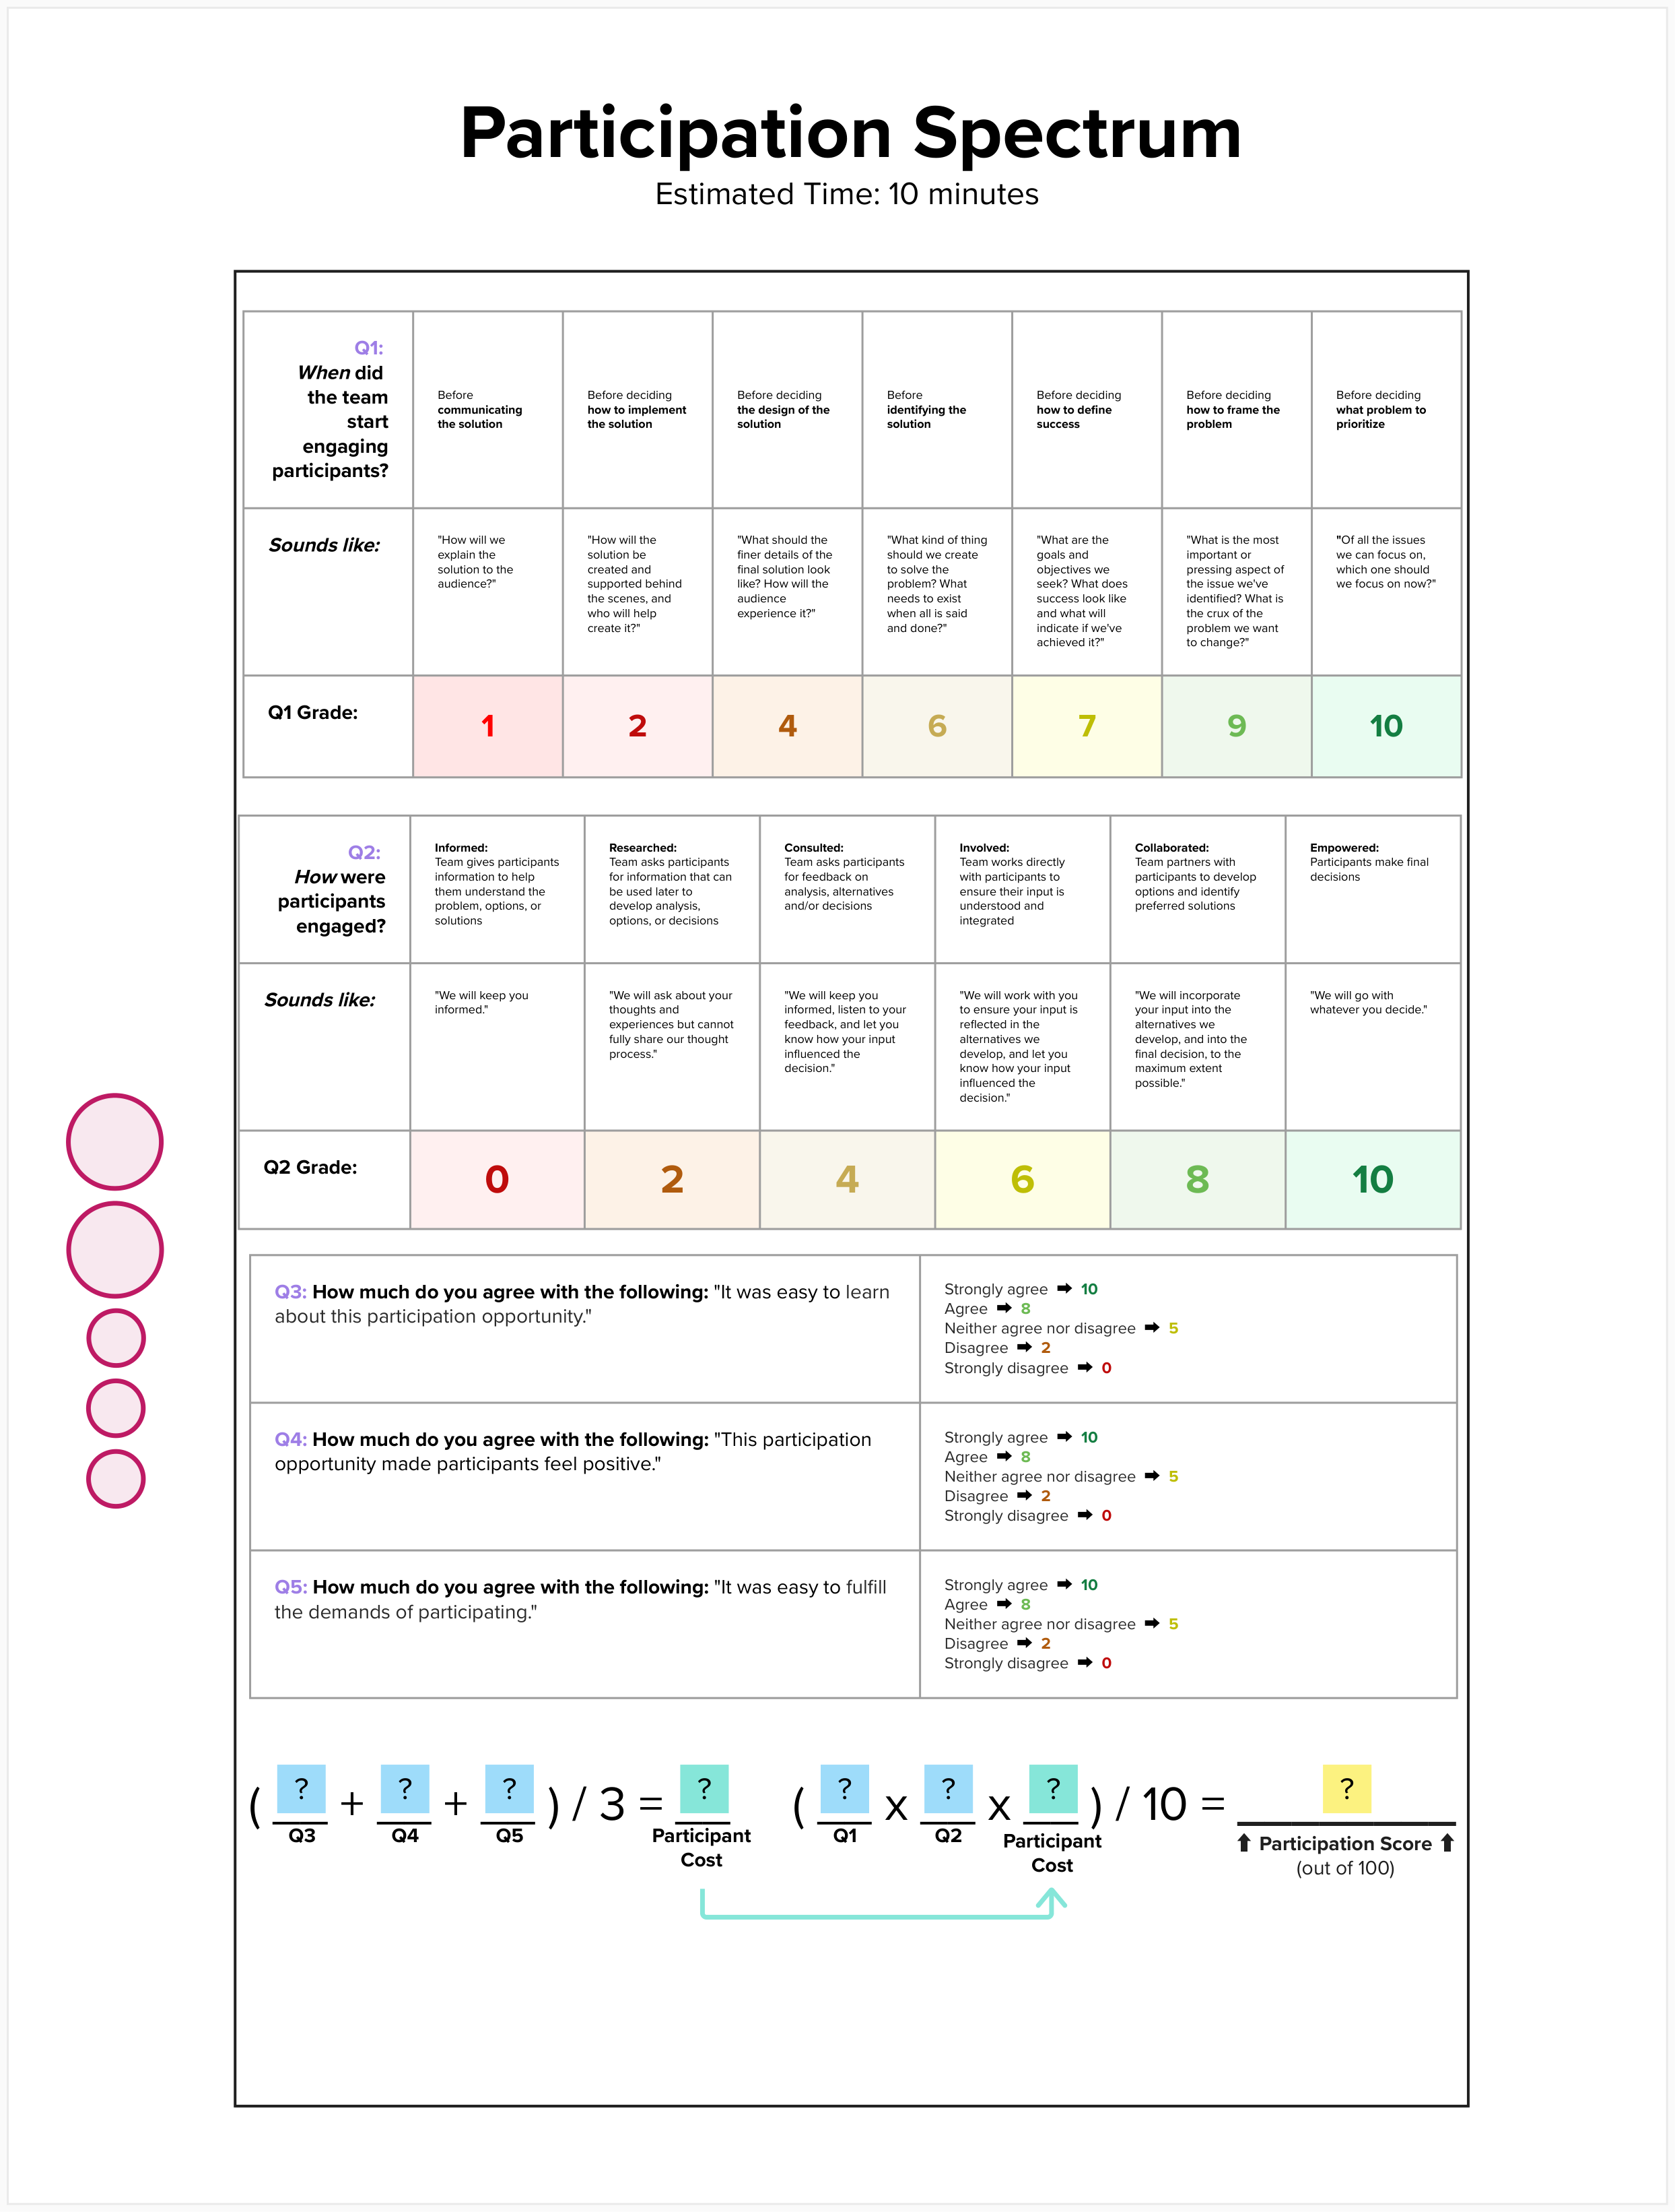
Participation spectrum
Design a meaningful approach to public participation that takes into account the timing, burden, and purpose of the participation.
Who’s using it: HRSA OPTN, SSA*, CX 0-5, DOJ NLEAD
Opportunities to use it: planning initial or expanded mid to long term engagement, evaluating current or planned engagement across one or more community partners
Notes:
Please do not add a stroke (outside border line) to photos or graphics.
To remove a stroke:
Right click on image
Choose “Format shape”
Under the paint bucket icon, expand the “Line”. Menu and choose “No line.”

Slide 13

We’re here to help you
Equity Delivery team can help you plan out a custom set of tools to create impact more equitably and lend a supportive ear when you need it most.
Grab some time with us https://web.polly.ai/3d8eoo
Notes:
Pro tip: Master slides are finicky! If you add a new quote layout from the master slide library, you’ll have to re-type the large quotation marks so they show up in ‘slideshow’ (presenting) mode. Don’t worry, we’ve already fixed that on this slide for you.

Slide 14
Equity can be built.
Let’s do it together.
Notes:
Pro tip: Make sure to use a consistent style throughout your document. Keep in mind that all headers should be Sentence case (not Title Case).

